Slide 1
Colors

Slide 2
Color Systems
In computer graphics, we use RGB colors. But…
  Can it represent all colors?
  Is it linear? For example,
    (1.0, 1.0, 1.0) is white
    (1.0, 0.0, 0.0) is red
    Is (1.0, 0.5, 0.5) half white and half red?
    Does the color (r, g, b)*0.5 look like the color (r, g, b) in half intensity?

Slide 3
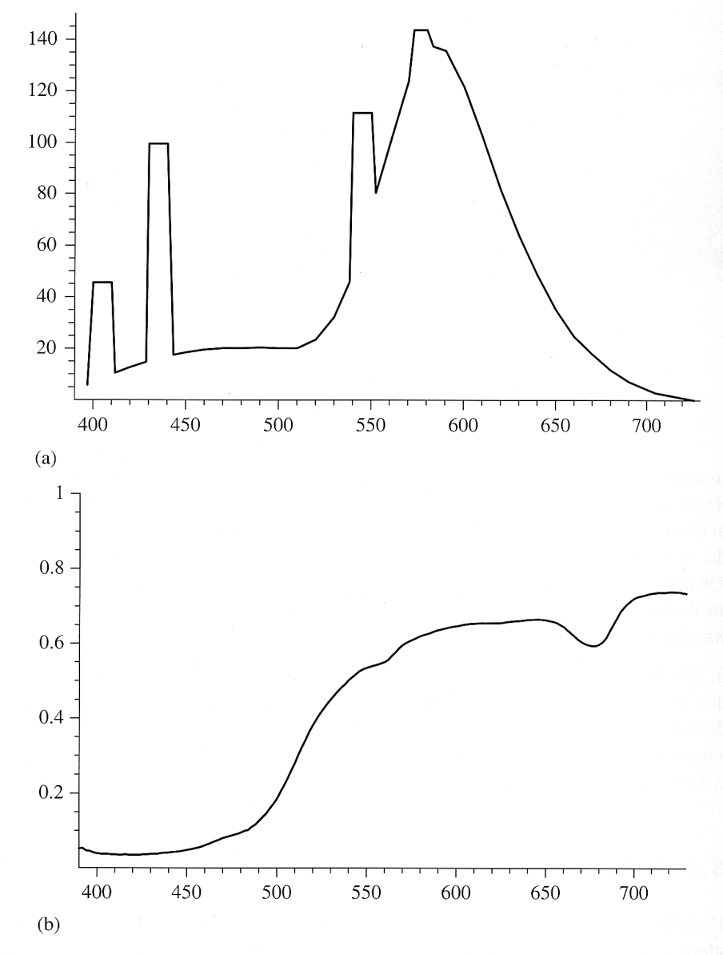
What is a Color, After All?
We may define a color by its wavelength. This is called Spectral Power Distribution (SPD)
However, most colors have energy spread in every wavelength.
Figure 5.1 in Pharr’s book:
Fluorescent light
Lemon skin

Slide 4
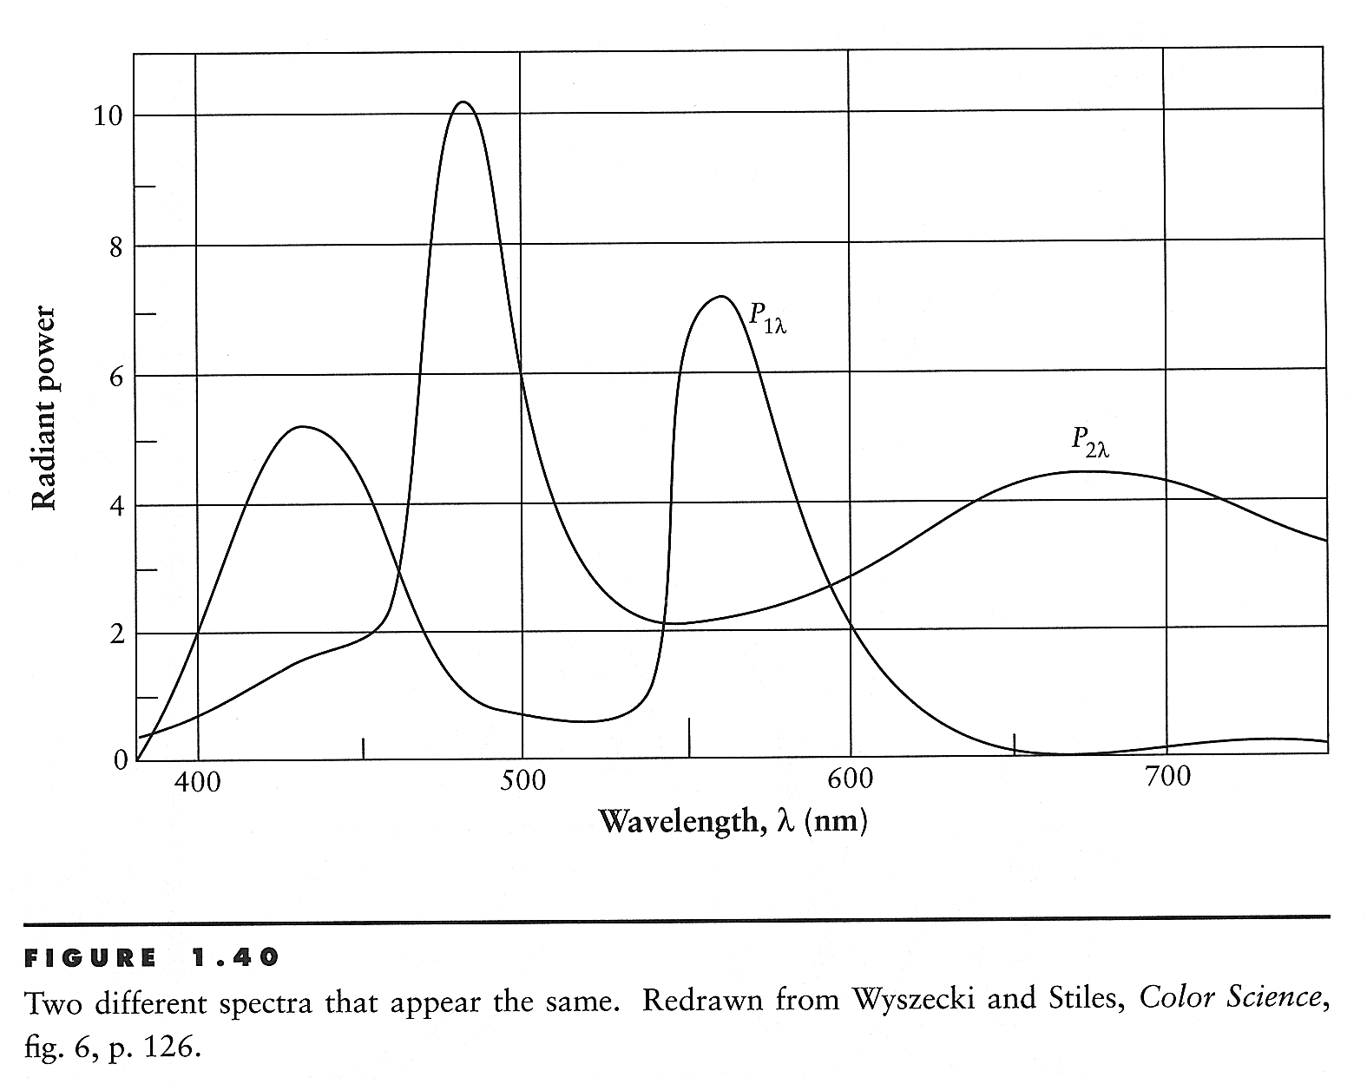
What is a Color (II)
What is more interesting is that different energy distributions may be perceived as the same color!

Slide 5
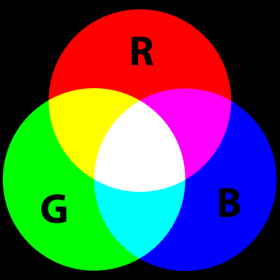
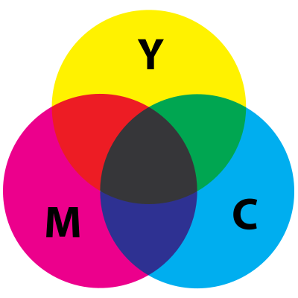
Additive vs. Subtractive Color

Slide 6
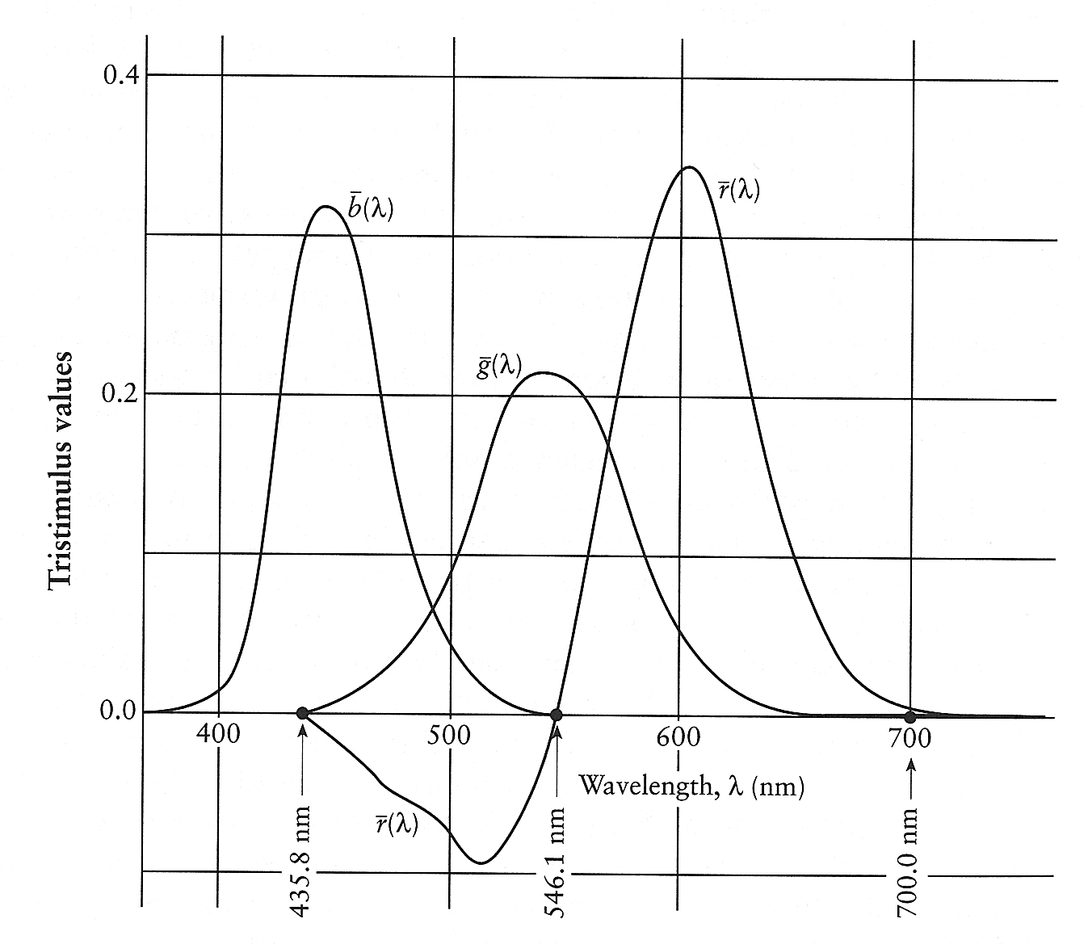
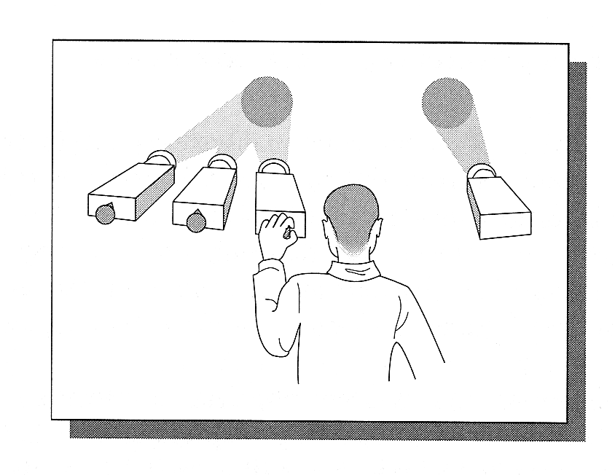
The CIE Color Matching

Slide 7
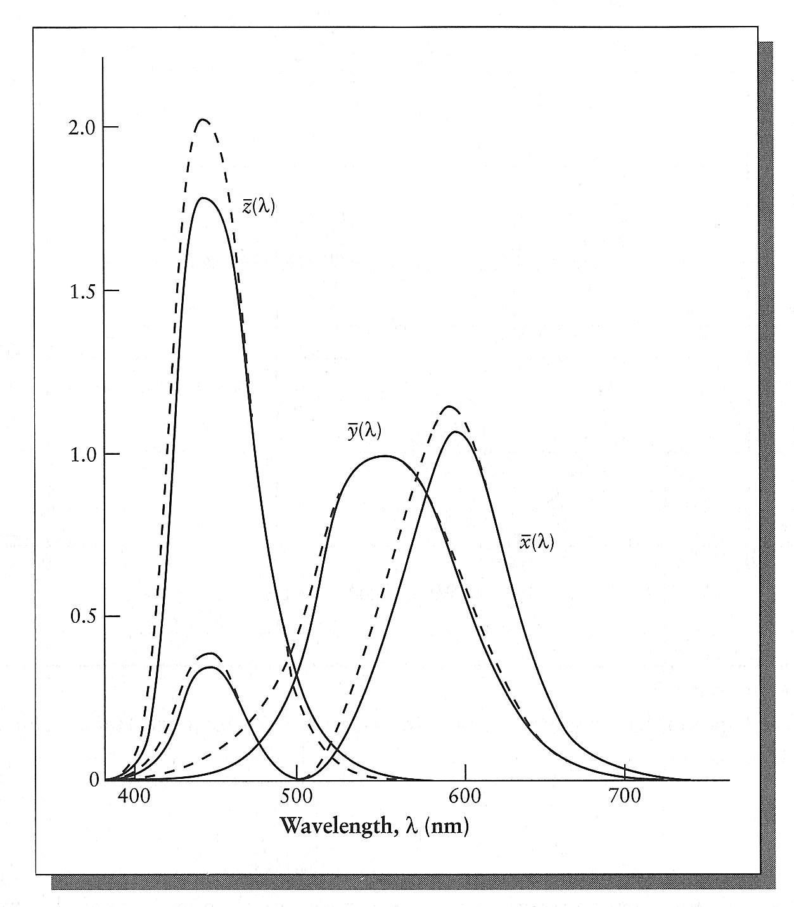
CIE XYZ Space
To get rid of the negative values, CIE defined 3 new hypothetical light sources .

Slide 8
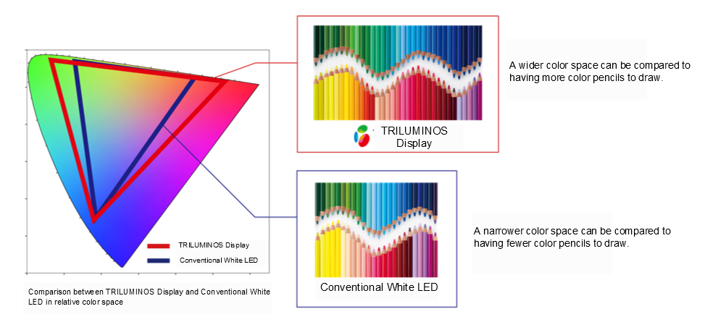
Color Gamut
Have you heard of “high color gamut” (廣色域)?
Example:
From http://community.sony.co.uk/t5/product-announcements-technologies/triluminos-display/ba-p/1308412

Slide 9
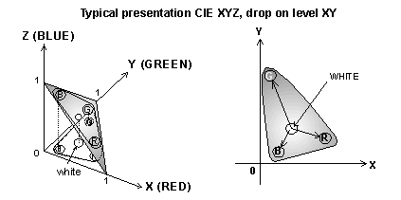
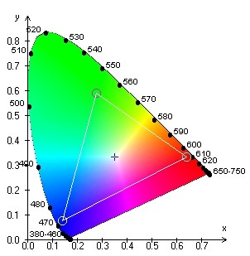
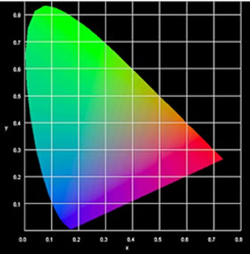

Slide 10
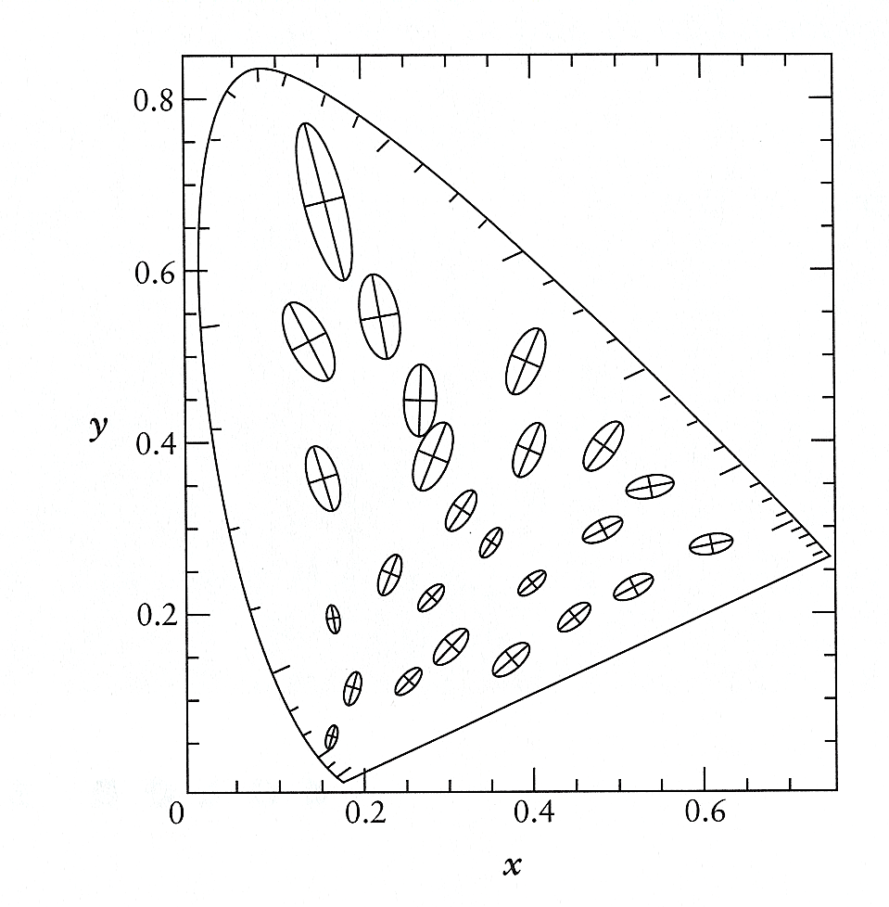
Linearity
Unfortunately equal steps in the XYZ space does not produce perceptually equal steps in the color.

Slide 11
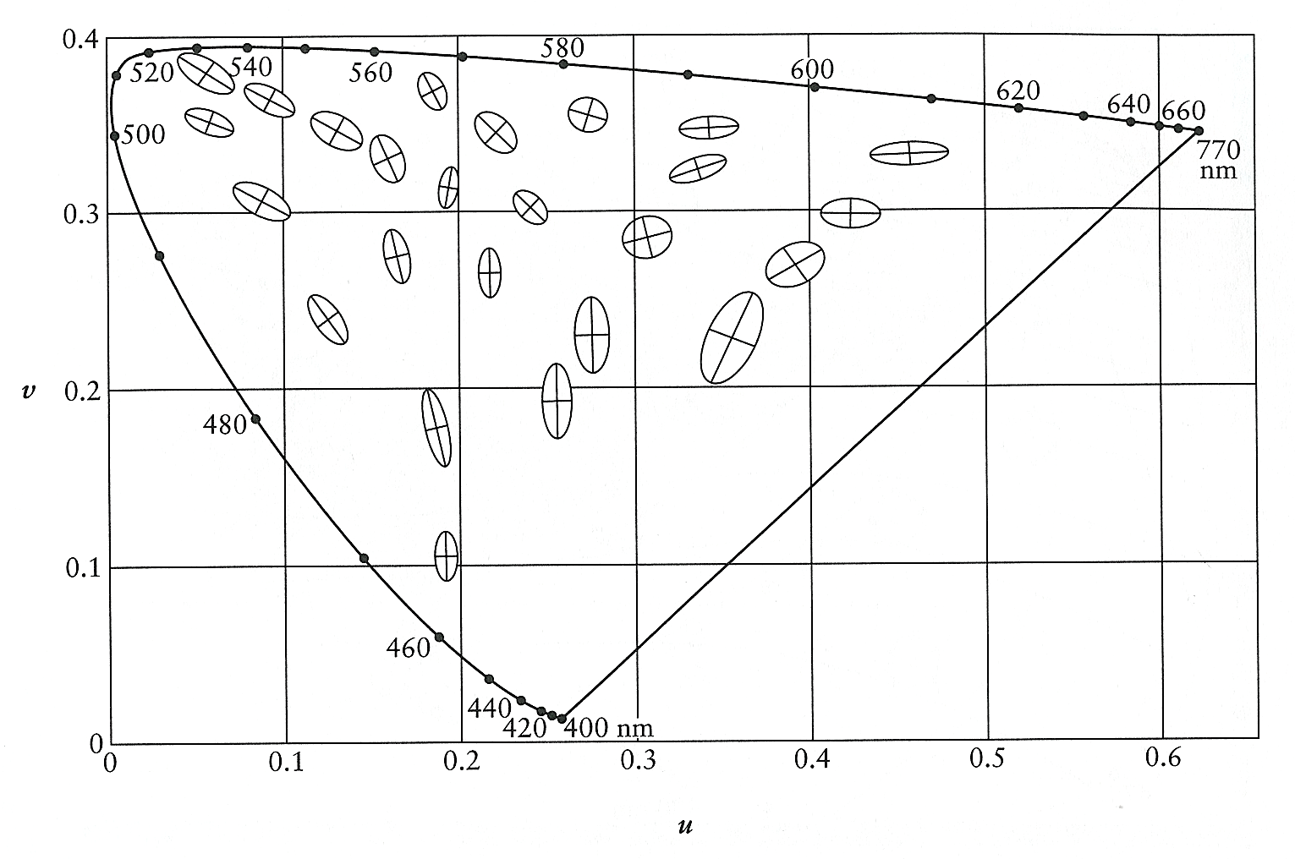
CIE L*u*v Space
Designed to be perceptually uniform.

Slide 12
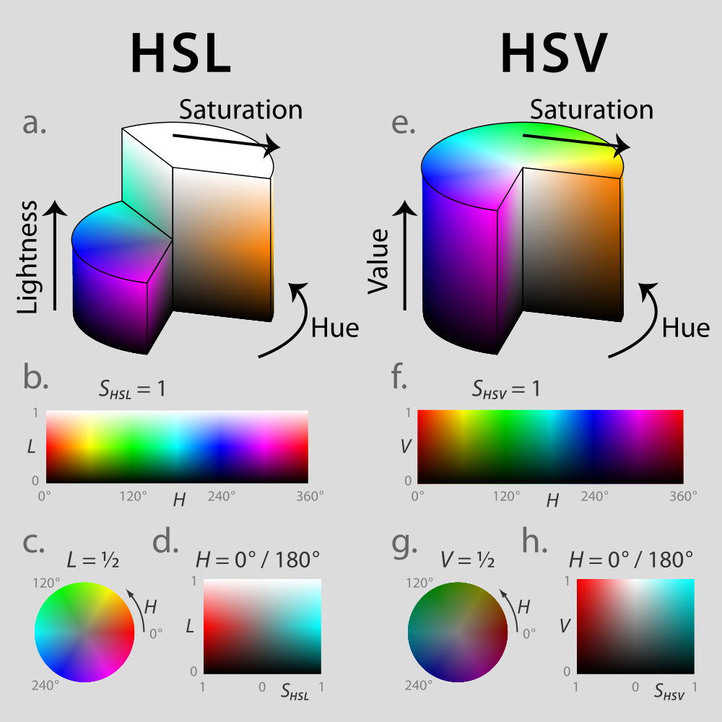
Other Color Space
HSV: hue, saturation, value.
HSL: hue, saturation, lightness._x0016_
From: http://en.wikipedia.org/wiki/File:Hsl-hsv_models.svg

Slide 13
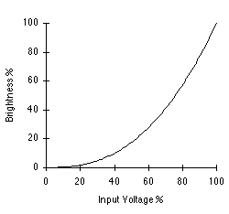
Gamma Correction
For a monitor, the light intensity follows an exponential curve such as:

Slide 14
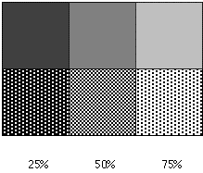
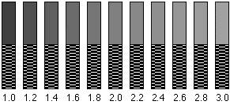
How to Determine the Gamma?
How to detect the gamma of your monitor? Compare it with dithering: (Hint: how do you produce a square with 50% gray on the screen?)

Slide 15
High Dynamic Range (HDR) Images

Slide 16
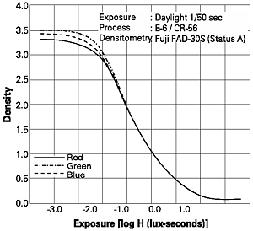
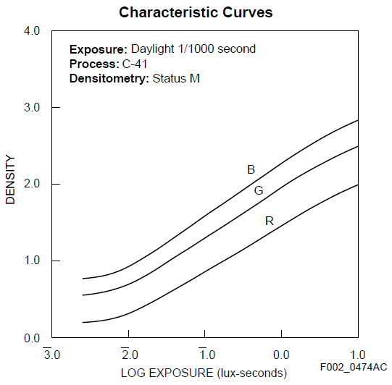
What is Dynamic Range?
What does the brightness (or darkness) mean in a photograph?

Slide 17
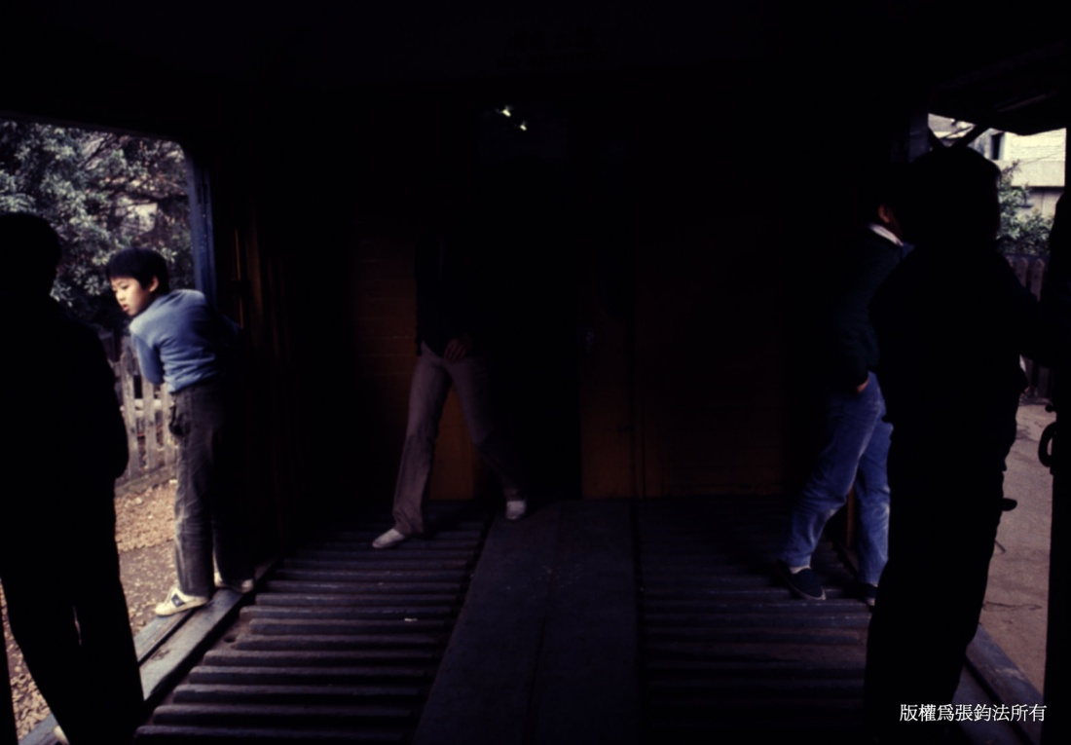
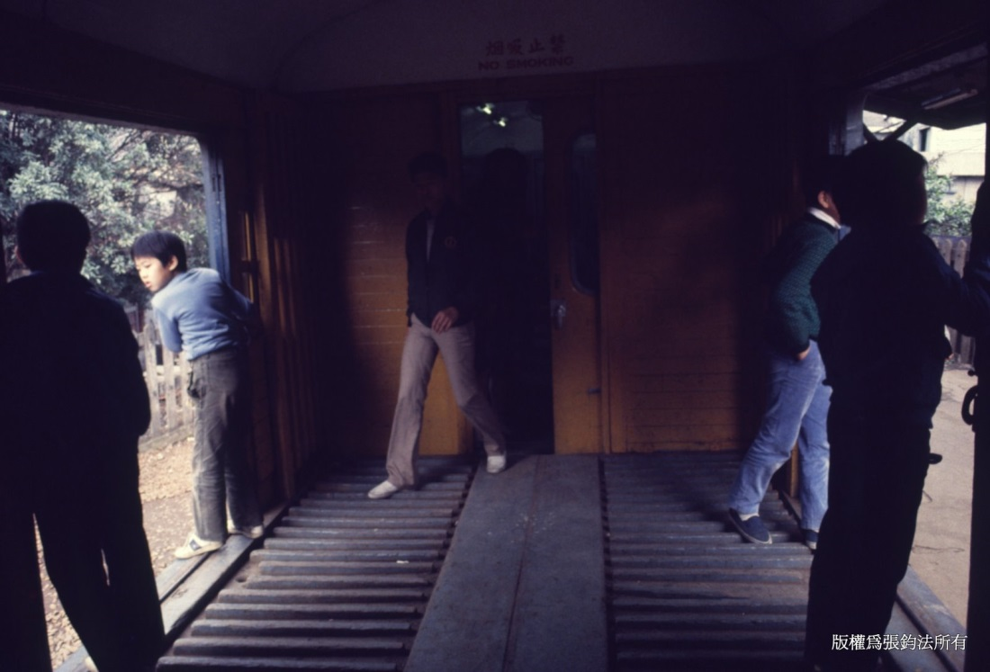
A Few Examples
See also:
http://en.wikipedia.org/wiki/High_dynamic_range_imaging

Slide 18
Recovering High Dynamic Range Radiance Maps from Photographs
By Paul Debevec (SIGGRAPH 1997)
Step 1: Recovering the film response curve.
Step 2: Recovering the radiance map given the response curve.

Slide 19
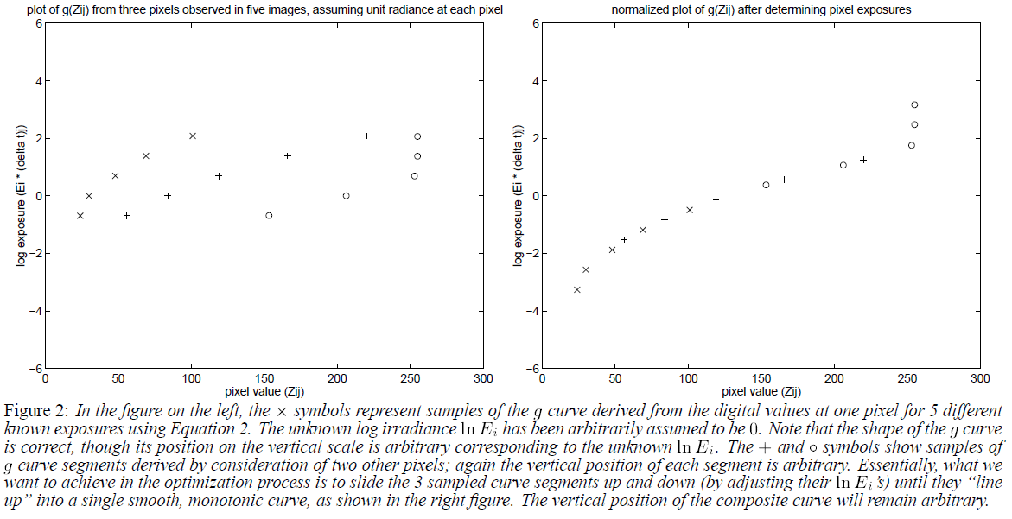
Recovering the Response Curve

Slide 20
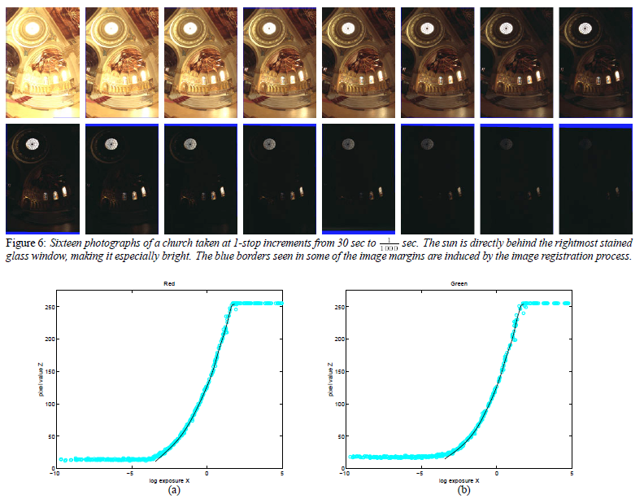

Slide 21

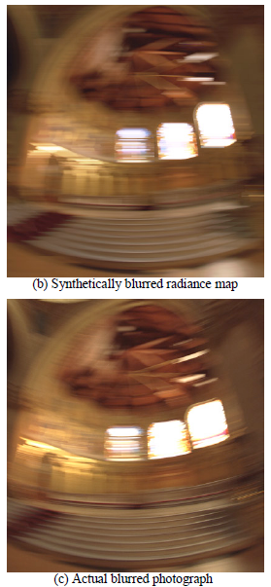
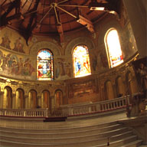

Slide 22
File Format
RGBE (.hdr) format that is used in Greg Ward’s RADIANCE.
OpenEXR: also used in Pharr’s PBRT
For more information, see:
  http://ict.debevec.org/~debevec/Research/HDR/
  http://en.wikipedia.org/wiki/High-dynamic-range_imaging

